Slide 1





Applying Data Science and Machine Learning using .Net
Scan this QR-code to access free resources, step-by-step learning guides as well as get practical experience in Azure ML and .NET!
https://aka.ms/AA94xtr
Don’t forget to add Microsoft Azure as a skill to your LinkedIn account to stay connected with a developer community!
+ Microsoft Azure
We post the latest announcements about free events for developers in Ireland on our official Twitter account!
@MSDevIRL

Slide 2

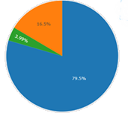
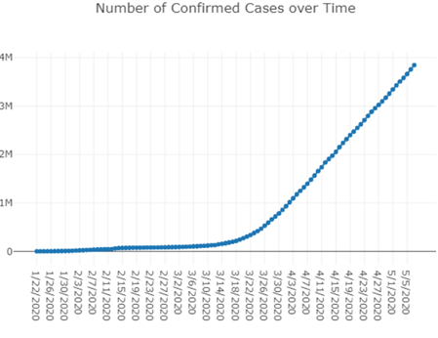
Applying Data Science and Machine Learning using Microsoft .Net
Praveen Raghuvanshi
03-Aug-2020

Slide 3


Introduction
Cloud Architect @ Harman, A Samsung Company
Domain: Audio, Video, Control
Area of Expertise: Cloud, Distributed computing
Area of Interest: AI/ML, Cloud and IoT
Location: Bangalore, India

Slide 4
Acknowledgements
Dataset - John Hopkins University CSSE
Python Visualization - Akshay Sb
Organizers – Cloud Lunch & Learn, Hugo and Lisa
Sponsors – Microsoft, Cloud Family and .Net Mafia

Slide 5
Identify language
Maidin mhaith
Guten Morgen
おはよ ございます
शुभ प्रभात
Good Morning

Slide 6



Programming Languages
Source: https://insights.dice.com/2019/10/24/tiobe-top-eight-top-ten-open/

Slide 7
What is DS and ML ?

Slide 8
Data Science : Exploratory Data Analysis - EDA
As per Wiki…
“In statistics, exploratory data analysis (EDA) is an approach of analyzing data sets to summarize their main characteristics, often with visual methods.
A statistical model can be used or not, but primarily EDA is for seeing what the data can tell us beyond the formal modeling or hypothesis testing task.”

Slide 9

EDA Contd…
Buy a house
No of bedrooms
Type(Apartment, Villa)
Locality
Crime rate

Slide 10
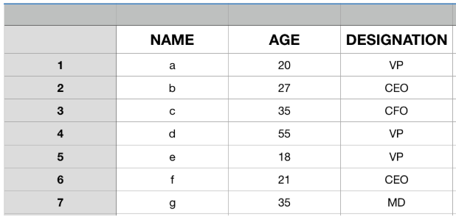
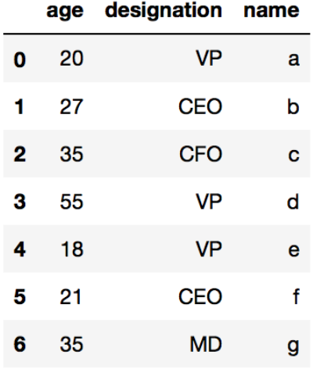
EDA Datastructure: DataFrame

Slide 11
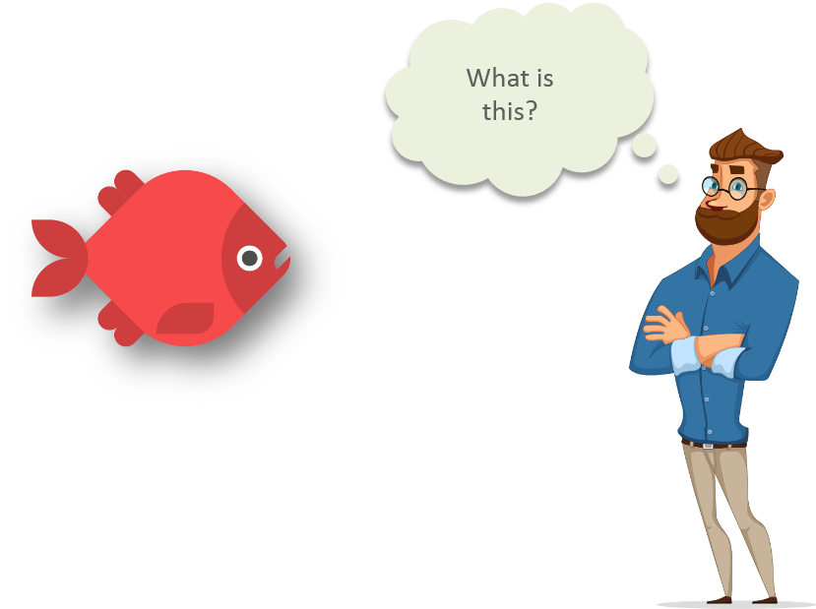
Machine Learning
Intellpaat: https://www.quora.com/What-are-prerequisites-to-start-learning-machine-learning

Slide 12
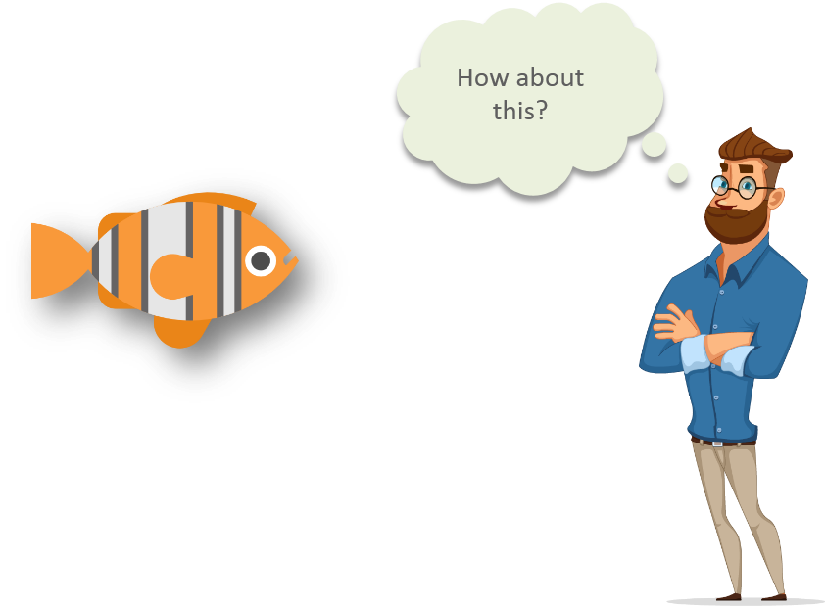
Machine Learning
Intellipaat: https://www.quora.com/What-are-prerequisites-to-start-learning-machine-learning

Slide 13
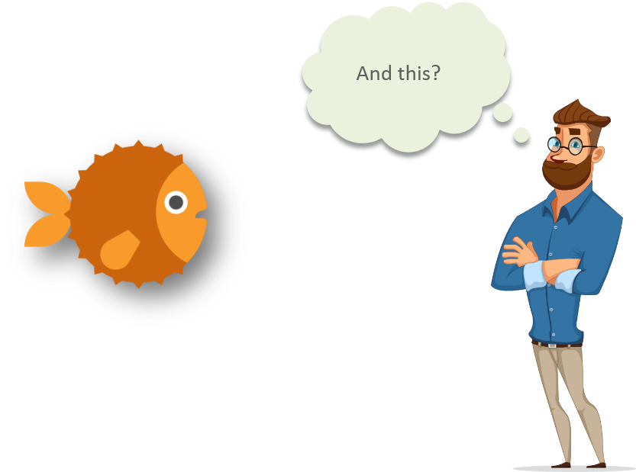
Machine Learning
Intellipaat: https://www.quora.com/What-are-prerequisites-to-start-learning-machine-learning

Slide 14
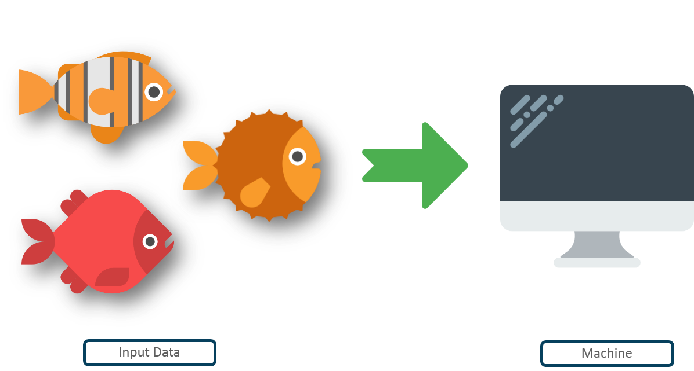
Machine Learning
Intellipaat: https://www.quora.com/What-are-prerequisites-to-start-learning-machine-learning

Slide 15
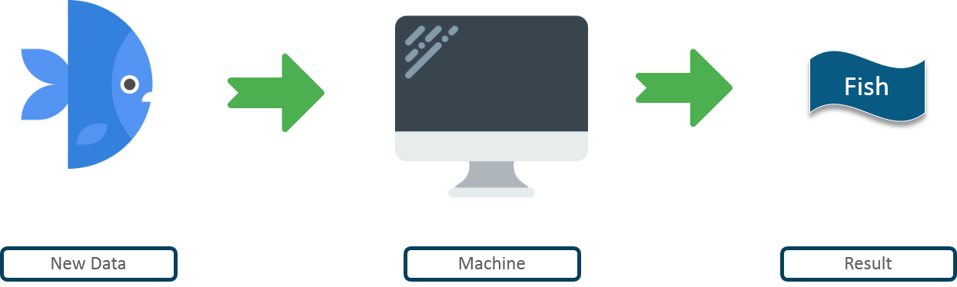
Machine Learning
Intellpaat: https://www.quora.com/What-are-prerequisites-to-start-learning-machine-learning

Slide 16
Machine learning
Machine learning is getting computers to program themselves
If programming is automation, then machine learning is automating the process of automation
Data
Program
Output
Data
Output
Program
Traditional Programming
Machine learning
Computer
Computer

Slide 17
Pre-Requisites of ML
A Pattern should exist
Mathematical model / algorithm is unknown
Lots of data

Slide 18
Types of Machine Learning
Supervised
Classification
Regression
Unsupervised
Clustering
Reinforcement Learning
Machine Learning

Slide 19
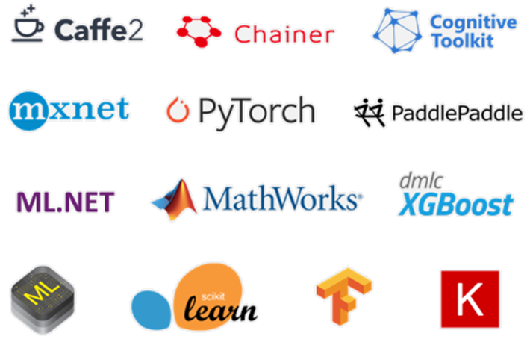
ML Frameworks

Slide 20
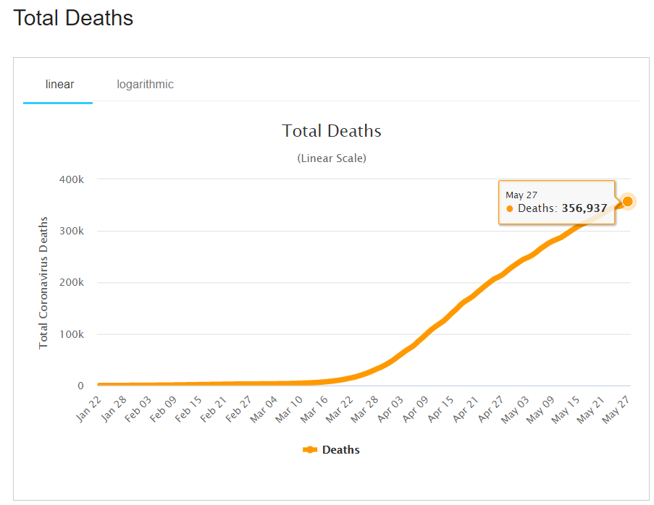
Predictions - Time Series Analysis
The analysis of data organized across units of time.
It helps understand past trends and plan for future
Types: Trends, Seasonality, Irregularity, Cyclic

Slide 21

Why ?

Slide 22
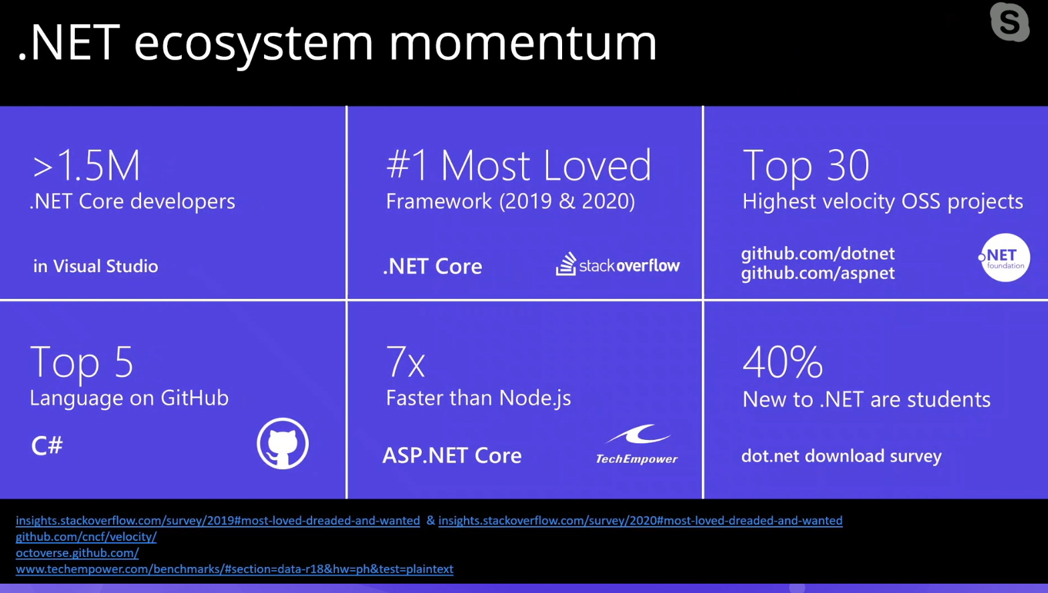

Slide 23
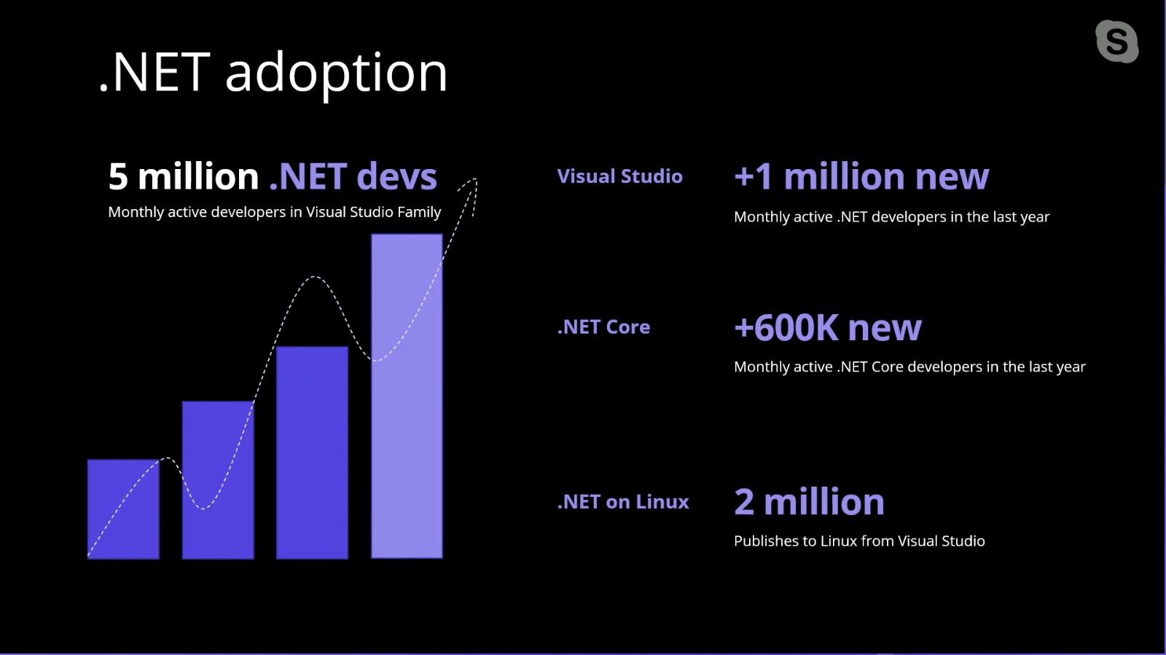

Slide 24
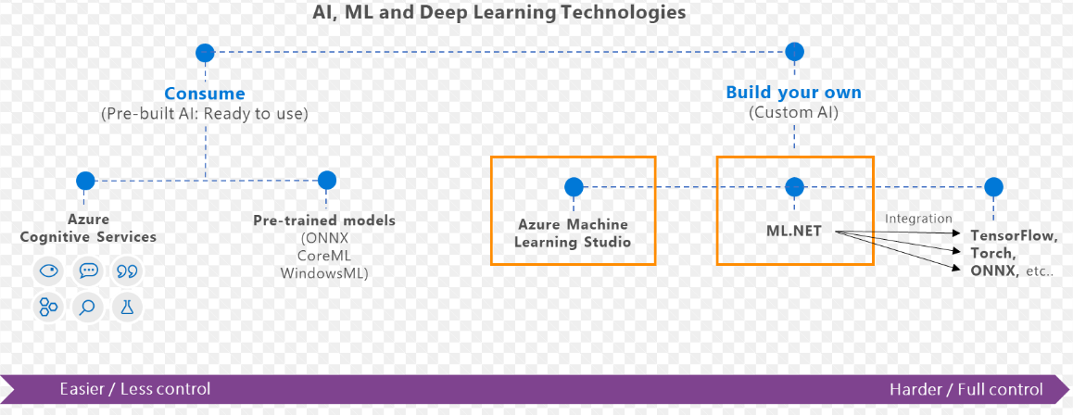
What is ML.Net?
ML framework from Microsoft for developing Custom AI/ML applications
Originated in 2002 as part of Microsoft Research project

Slide 25
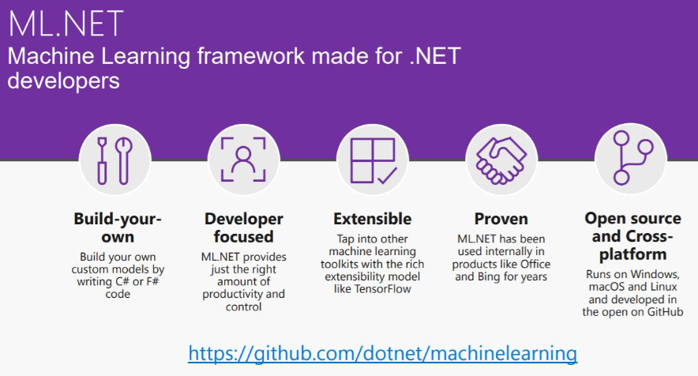

Slide 26
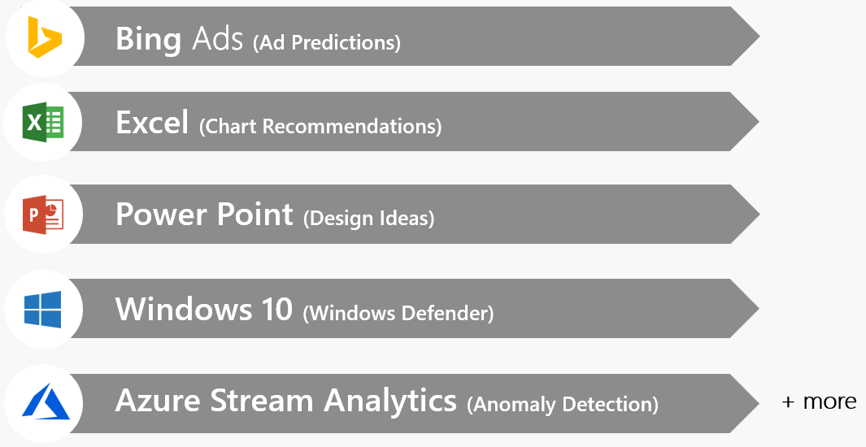
Proven at scale, Enterprise ready

Slide 27
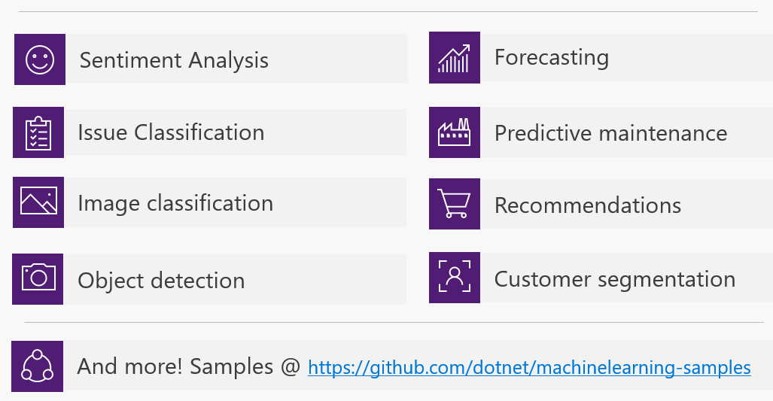
Possibilities

Slide 28
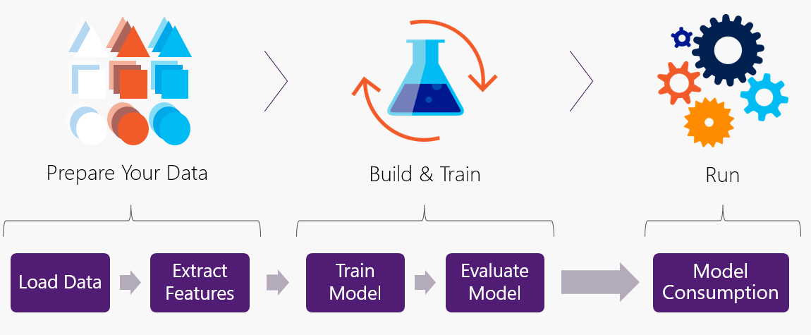
Workflow

Slide 29
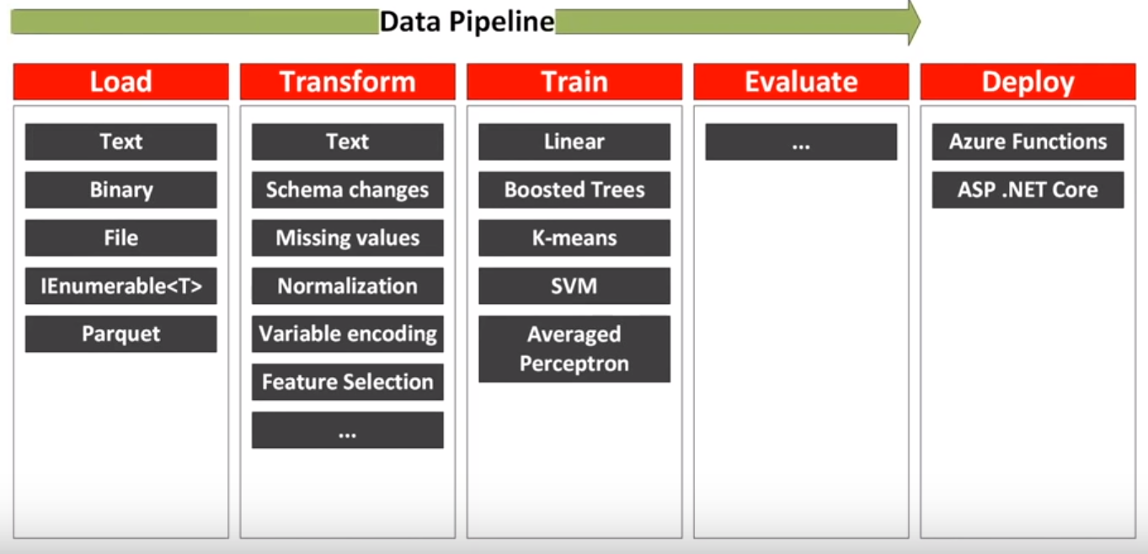
Data pipeline

Slide 30
Applying EDA and ML on COVID-19 dataset

Slide 31

COVID-19
As per Wiki…
“Coronavirus disease 2019(COVID-19) is an infectious disease caused by severe acute respiratory syndrome coronavirus 2 (SARS-CoV-2).
The disease was first identified in 2019 in Wuhan, the capital of China's Hubei province, and has since spread globally, resulting in the ongoing 2019–20 coronavirus pandemic”
Image Source: https://www.theweek.in/news/india/2020/03/29/coronavirus-will-see-its-end-soon-say-renowned-astrologers.html

Slide 32
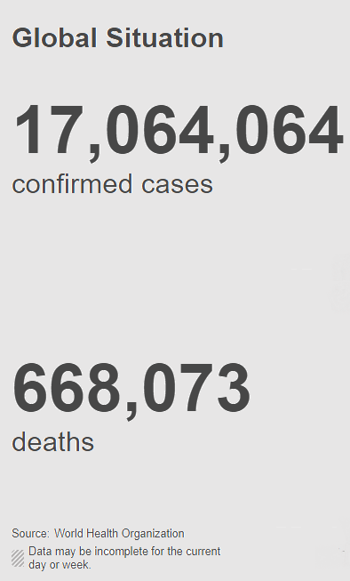
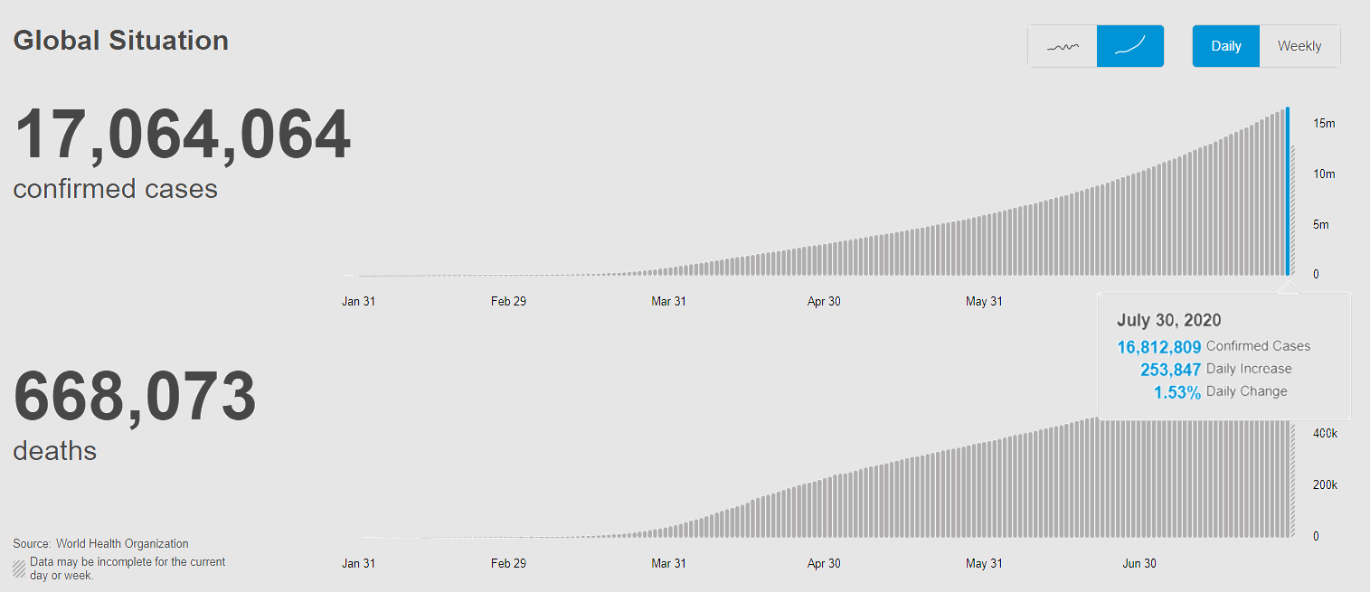
COVID-19 (Statistics) : July 30, 2020
Source: https://covid19.who.int/

Slide 33
EDA using .Net DataFrame
A collection of columns
In-memory representation of structured data
Similar to Python Dataframe
Load dataset from CSV
Row/Column Selection
Join/Merge Dataframe
GroupBy
Null values

Slide 34
Machine Learning using ML.Net
Single Spectrum Analysis
TimeSeriesCatalog.ForecastBySsa
Time Series
Load Data – MLContext
ML Pipeline
Predicting confirmed cases in next 7 days
Notes:
SSA is a powerful framework for decomposing the time-series into trend, seasonality and noise components as well as forecasting the future values of the time-series.
In principle, SSA performs spectral analysis on the input time-series where each component in the spectrum corresponds to a trend, seasonal or noise component in the time-series. For details of the Singular Spectrum Analysis (SSA), refer to this document.

Slide 35
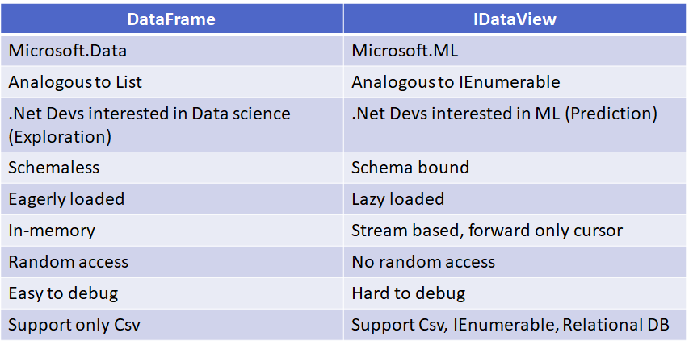
.Net DataFrame Vs IDataView
Notes:
- SQL Server, Azure SQL Database, Oracle, SQLite, PostgreSQL, Progress, IBM DB2

Slide 36
Visualization
Xplot – Plotly
Bar
Scatter
Pie

Slide 37
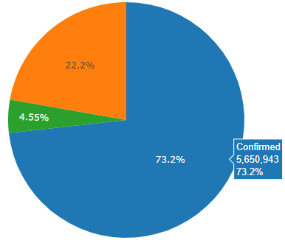
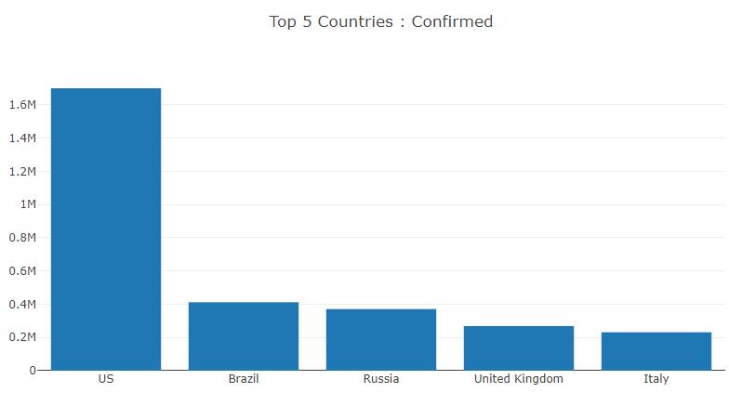
Data Science - DataFrame

Slide 38
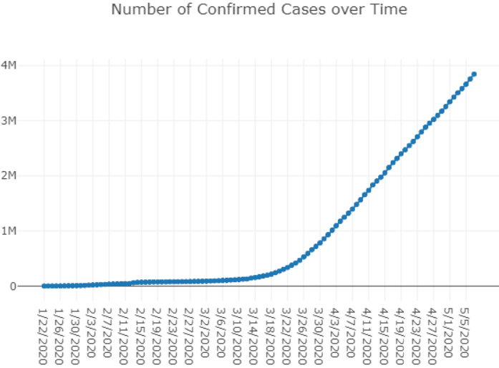
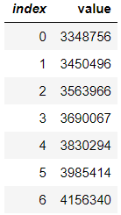
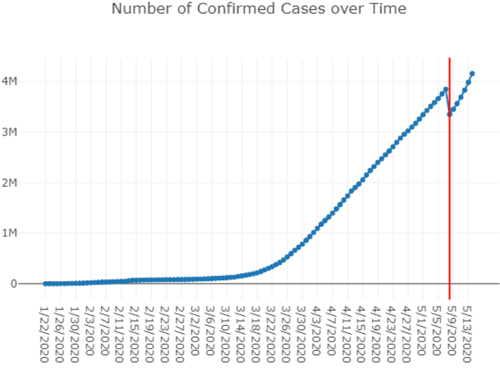
Machine Learning : ML.Net – Prediction(7 Days)

Slide 39
Demo

Slide 40
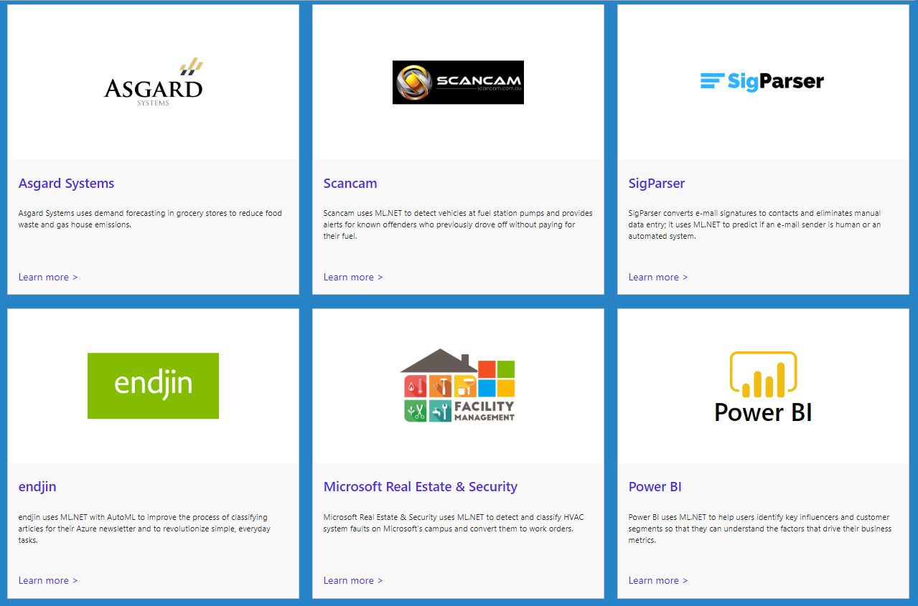
https://dotnet.microsoft.com/apps/machinelearning-ai/ml-dotnet/customers

Slide 41
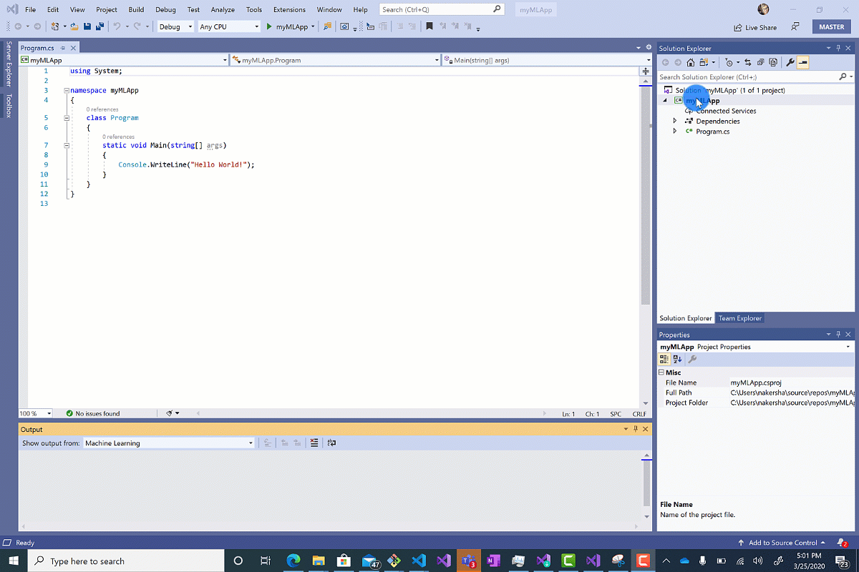
Model Builder : AutoML

Slide 42
References
ML.Net : https://dotnet.microsoft.com/apps/machinelearning-ai/ml-dotnet
ML.Net: https://devblogs.microsoft.com/cesardelatorre/what-is-ml-net-1-0-machine-learning-for-net/
ONNX : https://onnx.ai/
Photo-Search (ONNX) : https://github.com/Tak-Au/Photo-Search
Music Repair : https://www.youtube.com/watch?v=nnV-1q-z9uE
ML Cookbook : https://github.com/dotnet/machinelearning/blob/master/docs/code/MlNetCookBook.md
Deploy to Azure functions : http://luisquintanilla.me/2018/08/21/serverless-machine-learning-mlnet-azure-functions/
https://rubikscode.net/2019/02/18/ultimate-guide-to-machine-learning-with-ml-net/
https://www.youtube.com/watch?v=dojO4zEL9sg
https://www.youtube.com/watch?v=zy7Y9CHji2k

Slide 43
Resources
Github: https://github.com/praveenraghuvanshi/tech-sessions/tree/master/03082020-AI-ML-using-ml-dotnet-dublin-meetup
Dev.to : https://dev.to/praveenraghuvanshi/covid-19-eda-and-prediction-using-net-dataframe-and-ml-net-c-introduction-nlb

Slide 44





Thank you Q & A
https://in.linkedin.com/in/praveenraghuvanshi
https://github.com/praveenraghuvanshi
@praveenraghuvan
https://t.me/joinchat/IifUJQ_PuYT757Turx-nLg

Slide 45
Applying Data Science and Machine Learning using .Net
Scan this QR-code to access free resources, step-by-step learning guides as well as get practical experience in Azure ML and .NET!
https://aka.ms/AA94xtr
Don’t forget to add Microsoft Azure as a skill to your LinkedIn account to stay connected with a developer community!
+ Microsoft Azure
We post the latest announcements about free events for developers in Ireland on our official Twitter account!
@MSDevIRL

